Slide 1
DevOps
Yuliia - Ismet - Sadettin - Enes

Slide 2
What DevOps is not
Specific technology
DevOps is not simply combining Development & Operations teams
DevOps is not a separate team
DevOps is not a tool
DevOps is not just automation

Slide 3
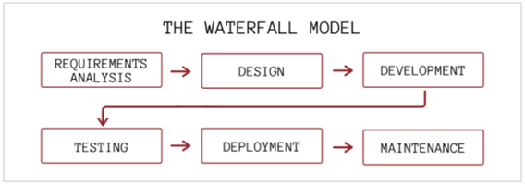
Waterfall Method

Slide 4
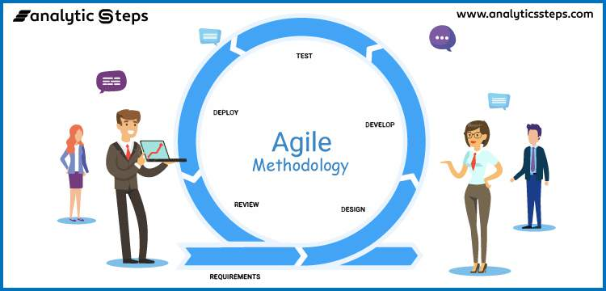
Agile Method

Slide 5
What DevOps is
“DevOps is the union of people, process, and products to enable continuous delivery of value to our end users.”
Donovan Brown, MSFT

Slide 6
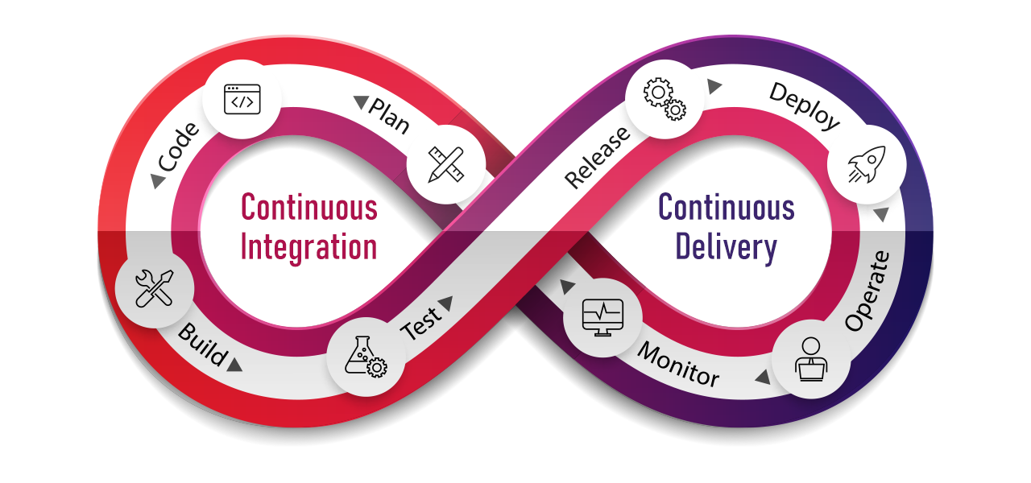
DevOps Method

Slide 7
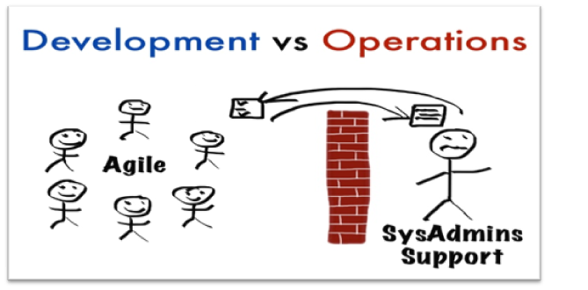
DevOps Vs Agile
DevOps enables collaboration between development and operation teams, while the Agile methodology makes developers and development cycles more efficient.

Slide 8
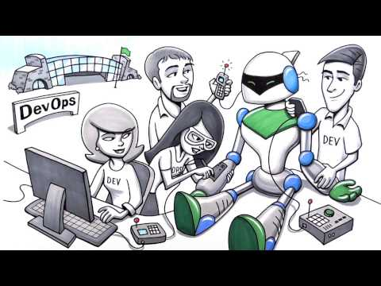
DevOps is :
Continuous integration,
Continuous delivery,
Continuous testing,
Continuous deployment,
Continuous operations,
Continuous collaboration

Slide 9
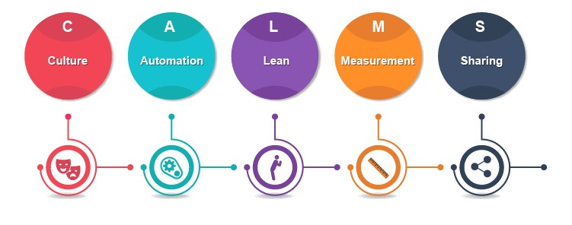
“CALMS MODEL”

Slide 10
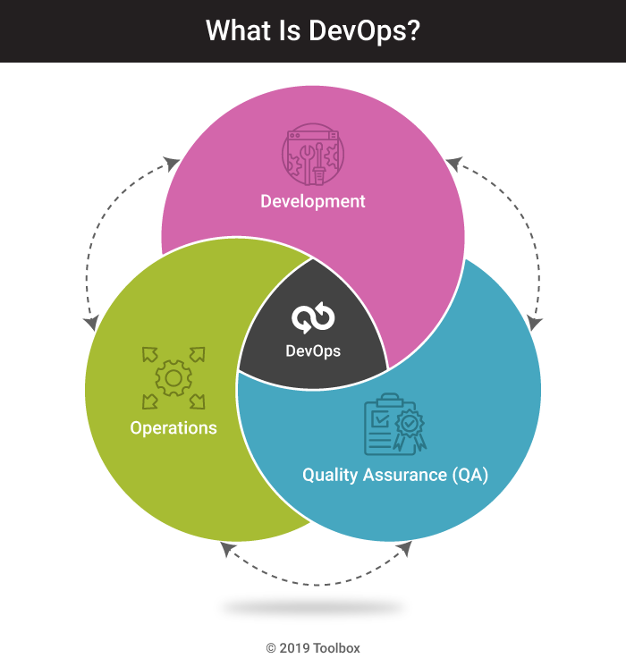
DevOps Teams
Multi-skilled teams
Developers, Sysadmins, and Testers

Slide 11
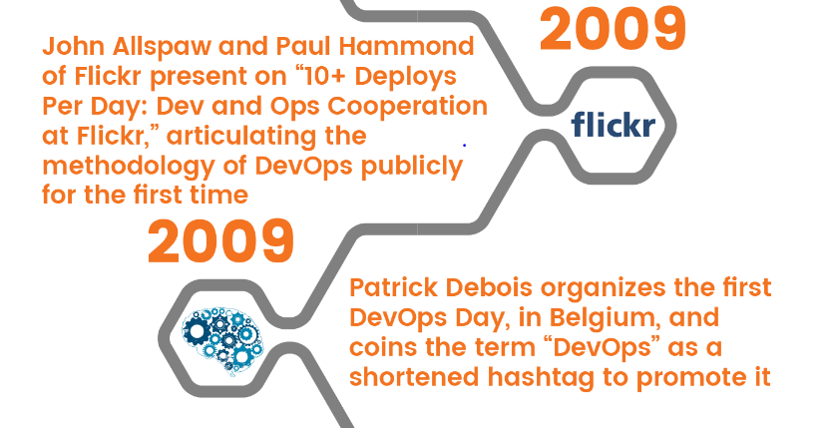
History

Slide 12
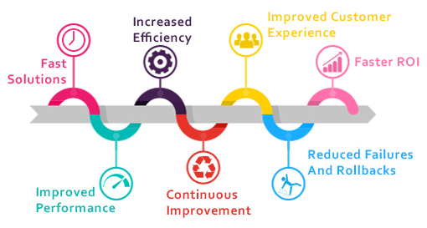
Why DevOps?

Slide 13
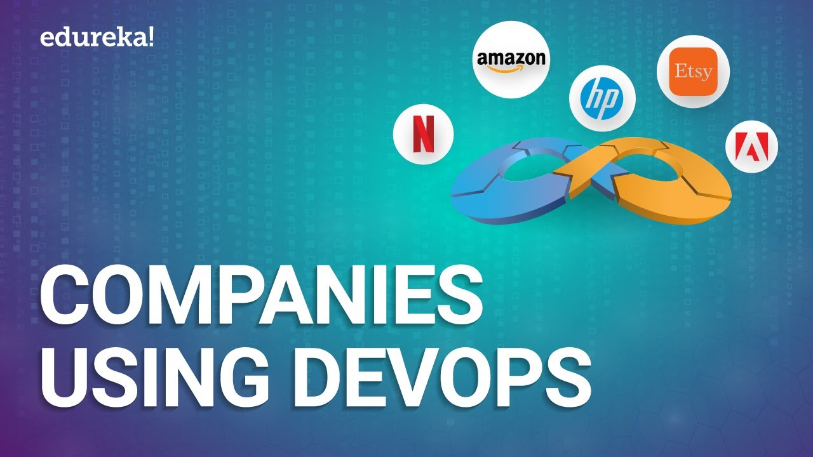

Slide 14
Tools of DevOps
“The most powerful tool we have as developers is automation.”
– Scott Hanselman

Slide 15
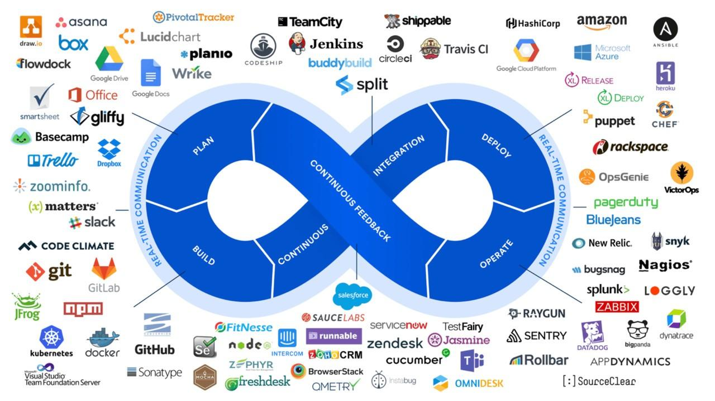
Notes:
There are dozens of tools out there to automate every aspect of DevOps. These are commercial or open source. XebiaLabs curated a list of 100+ tools arranged as a "periodic table". They also published a list of open source tools.
The right DevOps tools can make the projects much simpler for your teams. These tools provide you with many benefits, from improving collaboration to handling various technical aspects.

Slide 16
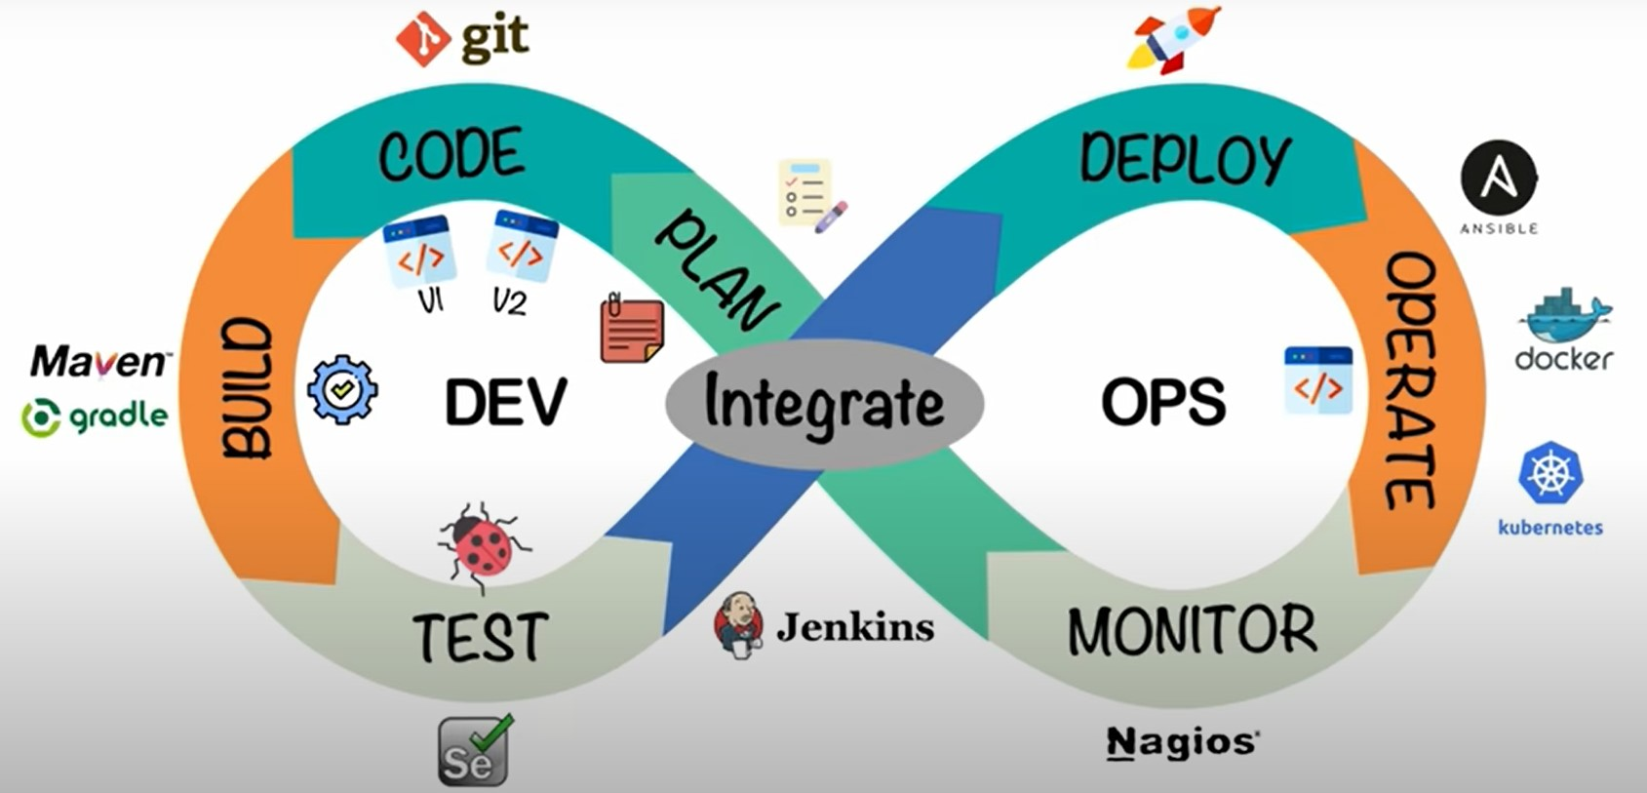
Notes:
On each step of DevOps we use different sets of tools:
Version Control Tool: Git (GitLab, GitHub, Bitbucket)
Build Tool: Maven
Continuous Integration Tool: Jenkins
Testing Tool: Selenium
Container Platforms: Docker, Kubernetes
Splunk Cloud: Monitoring, Alerting, and Incident Response Tools

Slide 17
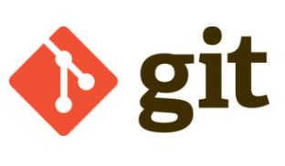
Git is an open-source, distributed and most popular software version control system.
It allows you to track changes in your file and, by using it you can easily coordinate the work among your team.
Popular companies like Google, Facebook, Microsoft, Netflix are extensively using Git .
Version Control Tool
Notes:
It is a version control system, and it lets teams collaborate on a project at the same time. Developers can track changes in their files, as well as improve the product regularly. Git is widely popular among tech companies. Many companies consider it is a must-have for their tech professionals.

Slide 18
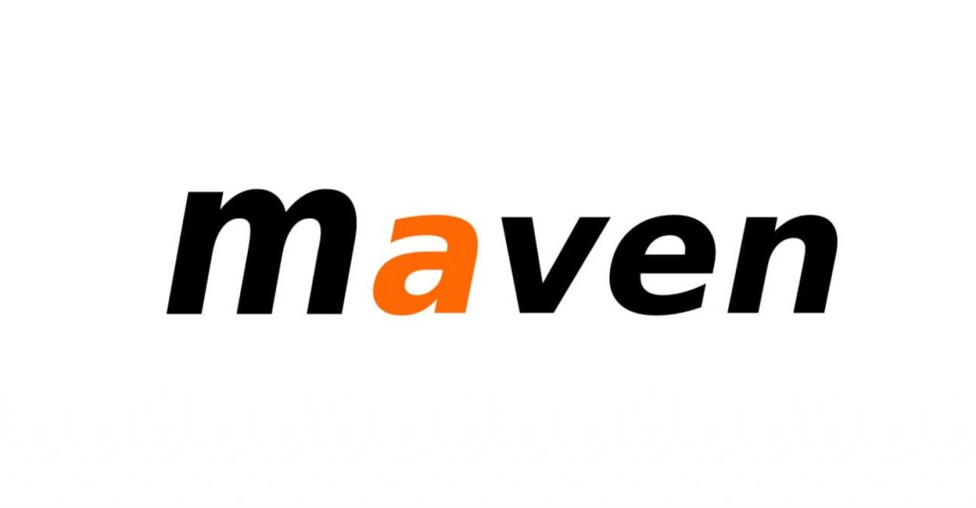
Build tool
Maven is one of the important DevOps tools for building projects. Apache Maven is more than just an automation build framework. It is also designed to manage reporting, documentation, distribution, releases, and dependencies processes. Written in Java language, Maven can build and manage projects written in Java or C#, Ruby, Scala, and other languages using project object model (POM) plugins.
Notes:
Maven offers a host of benefits to its users. It eases the build and monitoring process through automation and maintains a uniform build process allowing for consistency and efficiency. This tool also offers comprehensive project information through quality documentation, a valuable resource for the development of best practices hence the name Maven, translated from the Yiddish language to mean accumulator of knowledge. Finally, Maven provides a very simplified feature migration process.
It has a rich repository of plugins to enhance the build process and wide compatibility with IDEs like Eclipse, JBuilder, MyEclipse, NetBeans, IntelliJ IDEA, and others.

Slide 19
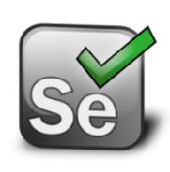
Testing Tool
Selenium is a free open source automated portable software testing framework for web applications. It is normally installed as a Firefox browser plugin and helps to record and playback of test scenarios.
Notes:
Key features of Selenium include:
Write test scripts in multiple languages like Java, Python, C#, Ruby, Perl, Php, JavaScript.
Supports Multi Platform for testing like ios and Android.
Easy to build a keyword-driven framework for a WebDriver.
Selenium comes with capabilities to support Selenium IDE, Selenium Grid, and Selenium Remote Control (RC).
Create robust, browser-based regression automation suites and tests.
ImpactQA is one of the largest companies that use Selenium for automated testing.

Slide 20
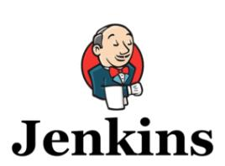
Continuous Integration & Deployment (CI/CD) Tools
Jenkins is a universal, customizable, open-source automation server written in Java. It allows you to automate various stages of the delivery pipeline. Its database contains over 1,000 plugins, allowing it to integrate with almost any DevOps tool you can imagine.
Companies like Capgemini, LinkedIn, AngularJS, Open stack, Luxoft, Pentaho etc are using Jenkins.
Notes:
Key features of Jenkins include:
Jenkins runs on Windows, Linux and Mac OS X.
Jenkins can be set up with a custom configuration or with plugins.
Script your pipeline having one or more build jobs into a single workflow.
Provides multiple ways of communication: web-based GUI, CLI and REST API.
Companies like Capgemini, LinkedIn, AngularJS, Open stack, Luxoft, Pentaho etc are using Jenkins.

Slide 21
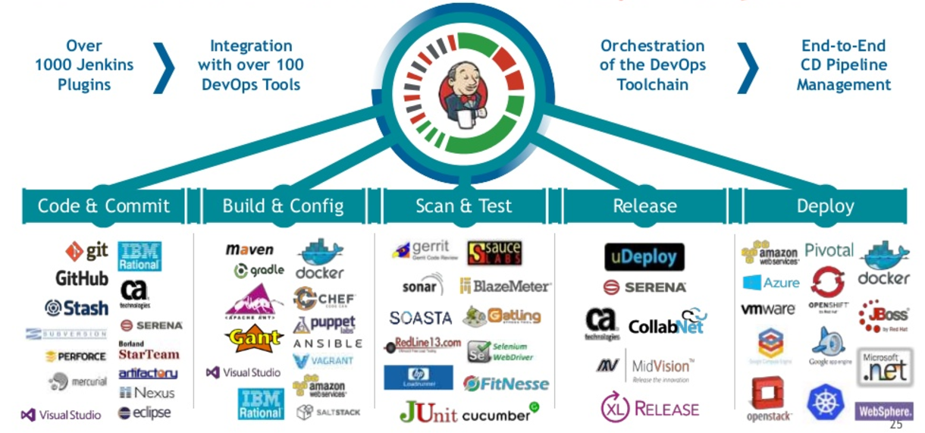
Notes:
DevOps are divided into different stages. For integrating them, you’d need to perform Continous Integration (CI). Jenkins is the tool that can help you in that regard. Jenkins enables companies to boost their software development processes. Developers use Jenkins to test their software projects and add changes seamlessly.
This tool uses Java with plugins, which help in enhancing Continuous Integration. Jenkins is widely popular with more 1 million users. So also get access to a thriving and helpful community of developers.

Slide 22
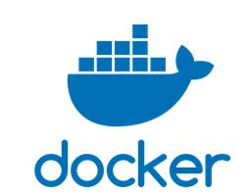
Container Platforms
Docker is a containerization technology that virtualizes the Operating System. It isolates applications into separate containers, so they become portable and more secure. You can package all the dependencies within the app’s container and ship the whole thing as an independent unit.
Companies like Uber, Ebay, PayPal, etc are already using Docker.
Notes:
Docker is a containerization technology that virtualizes the Operating System. It isolates applications into separate containers, so they become portable and more secure. You can package all the dependencies within the app’s container and ship the whole thing as an independent unit.
Key features of Docker include:
Google Cloud and AWS both offer built-in support for Docker.
Use Docker container with any language.
CaaS Ready platform running with built-in orchestration.
Flexible image management with a private registry to store, manage images and configure image caches.
Isolates apps in containers to eliminate conflicts for enhancing security.
Update with zero downtime.
Companies like Uber, Ebay, PayPal, etc are already using Docker.

Slide 23
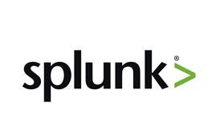
Monitoring, Alerting, and Incident Response Tools
Splunk is a software platform used to search, analyze, visualize and convert machine data into valuable information. It allows bringing operational intelligence into the DevOps teams.
Companies like Cisco, Facebook, Bosch, Motorola, IBM, etc are already using Splunk.
Notes:
Splunk makes machine data more accessible and valuable. It enables your organization to use the available data in a better fashion. With its help, you can easily monitor and analyze the available data and act accordingly. Splunk also lets you get a unified look at all the IT data present in your enterprise.
Key features of Splunk include:
Create knowledge objects for operational intelligence.
With the help of Splunk Cloud, Splunk can be deployed and managed as a service.
Delivers a single, unified view of different IT services.
Built for the cloud, Splunk Cloud delivers real-time visibility into cloud, hybrid, and on-prem environments to offer the best cloud monitoring solution for DevOps teams. Splunk Cloud will monitor performance for cloud infrastructure, applications, and services. It comes with powerful dashboards and integrations with most CI/CD tools, operation support systems (OSS), Kafka, AWS, Azure, Google Cloud Platform (GCP), Pivotal Cloud Foundry (PCF), and others.

Slide 24
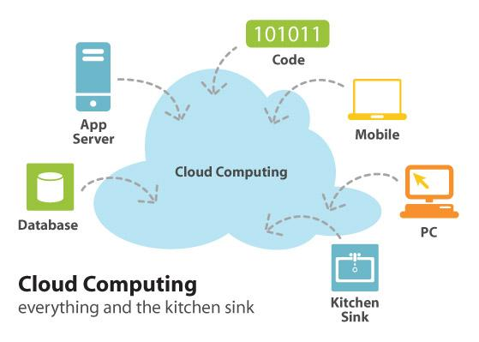
Cloud Computing and Storage
Notes:
Cloud computing simplifies DevOps implementation by extending every stage of the development lifecycle. With the cloud, applications can be built and tested in a variety of environments. By removing the need to test on physical machines, time is saved and costs are reduced. The beauty of the cloud and other software-as-a-service (SaaS) platforms is that you only pay for what you need, when you need it.
Cloud computing also gives teams the ability to collaborate with each other from around the world without having to travel to the office every time a change needs to be done.

Slide 25

The biggest advantage of cloud technology is moving operations and systems to the cloud. It allows to avoid the costs associated with data centers, hardware, operating systems and their management.
Amazon Web Services (AWS), Microsoft Azure and Google Cloud Services (GCS) are the three leading cloud services that offer servers, storage, computing, networking and other services on demand under a pay-per-use model.
Notes:
AWS Cloud Computing and Storage in DevOps
AWS features the widest range of service offerings under PaaS, SaaS, and IaaS categories including compute, identity and access management (ACM), networking, and storage. While AWS offers public, private, and hybrid clouds, its focus is more on the public cloud.
Azure Cloud Computing and Storage in DevOps
Microsoft Azure, on the other hand, is a preferred choice for enterprises particularly those that rely on Microsoft applications like Office, Outlook, and Windows thanks to an easier transition.
Azure offers Azure DevOps, a service packaged with a suite of tools to manage software development projects end to end. This service comprises the Azure DevOps Server and the Azure DevOps cloud service.
The server provides a run-time environment with cloud-based tools to facilitate on-premise deployments.
Cloud service, on the other hand, features tools such as Azure boards, Azure Pipeline, Azure reports, Azure test plans, and Azure artifacts for software development, testing, and deployment on the cloud.
Google Cloud Platform Cloud Computing and Storage in DevOps
GCP supports DevOps by providing the services required to develop, store, and deploy high-quality software in shorter cycles. The Google Cloud platform features instances of up to 96 vCPUs and 624 GB RAM alongside services like the cloud console, Google compute engine, and the GCP deployment manager that supports the implementation of DevOps on the Google Cloud Platform.
In addition, Google Cloud features impressive technical expertise as well as artificial intelligence, machine learning, and data analytics capabilities.

Slide 26
DevOps
Roadmap
Programming languages
Operating systems
Review networking security and protocols
Infrastructure as code
Public cloud

Slide 27

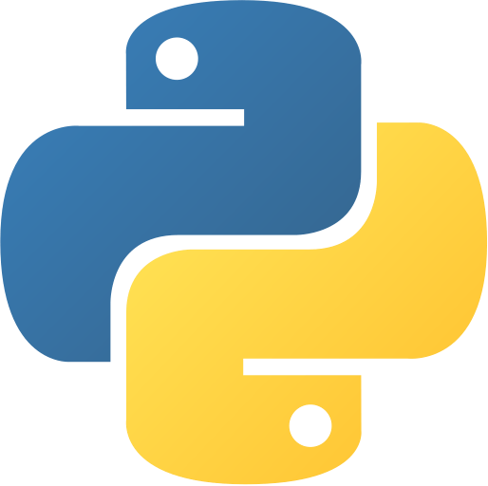
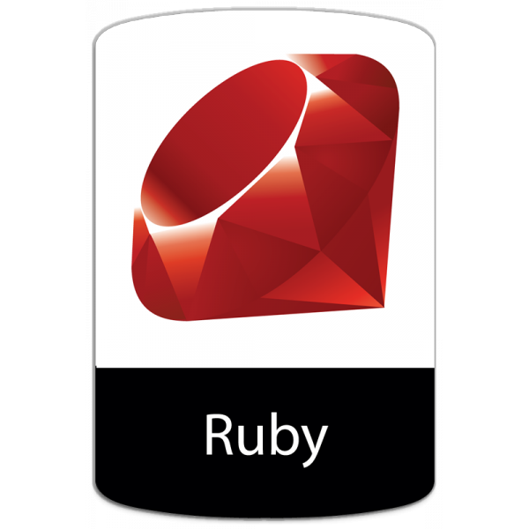
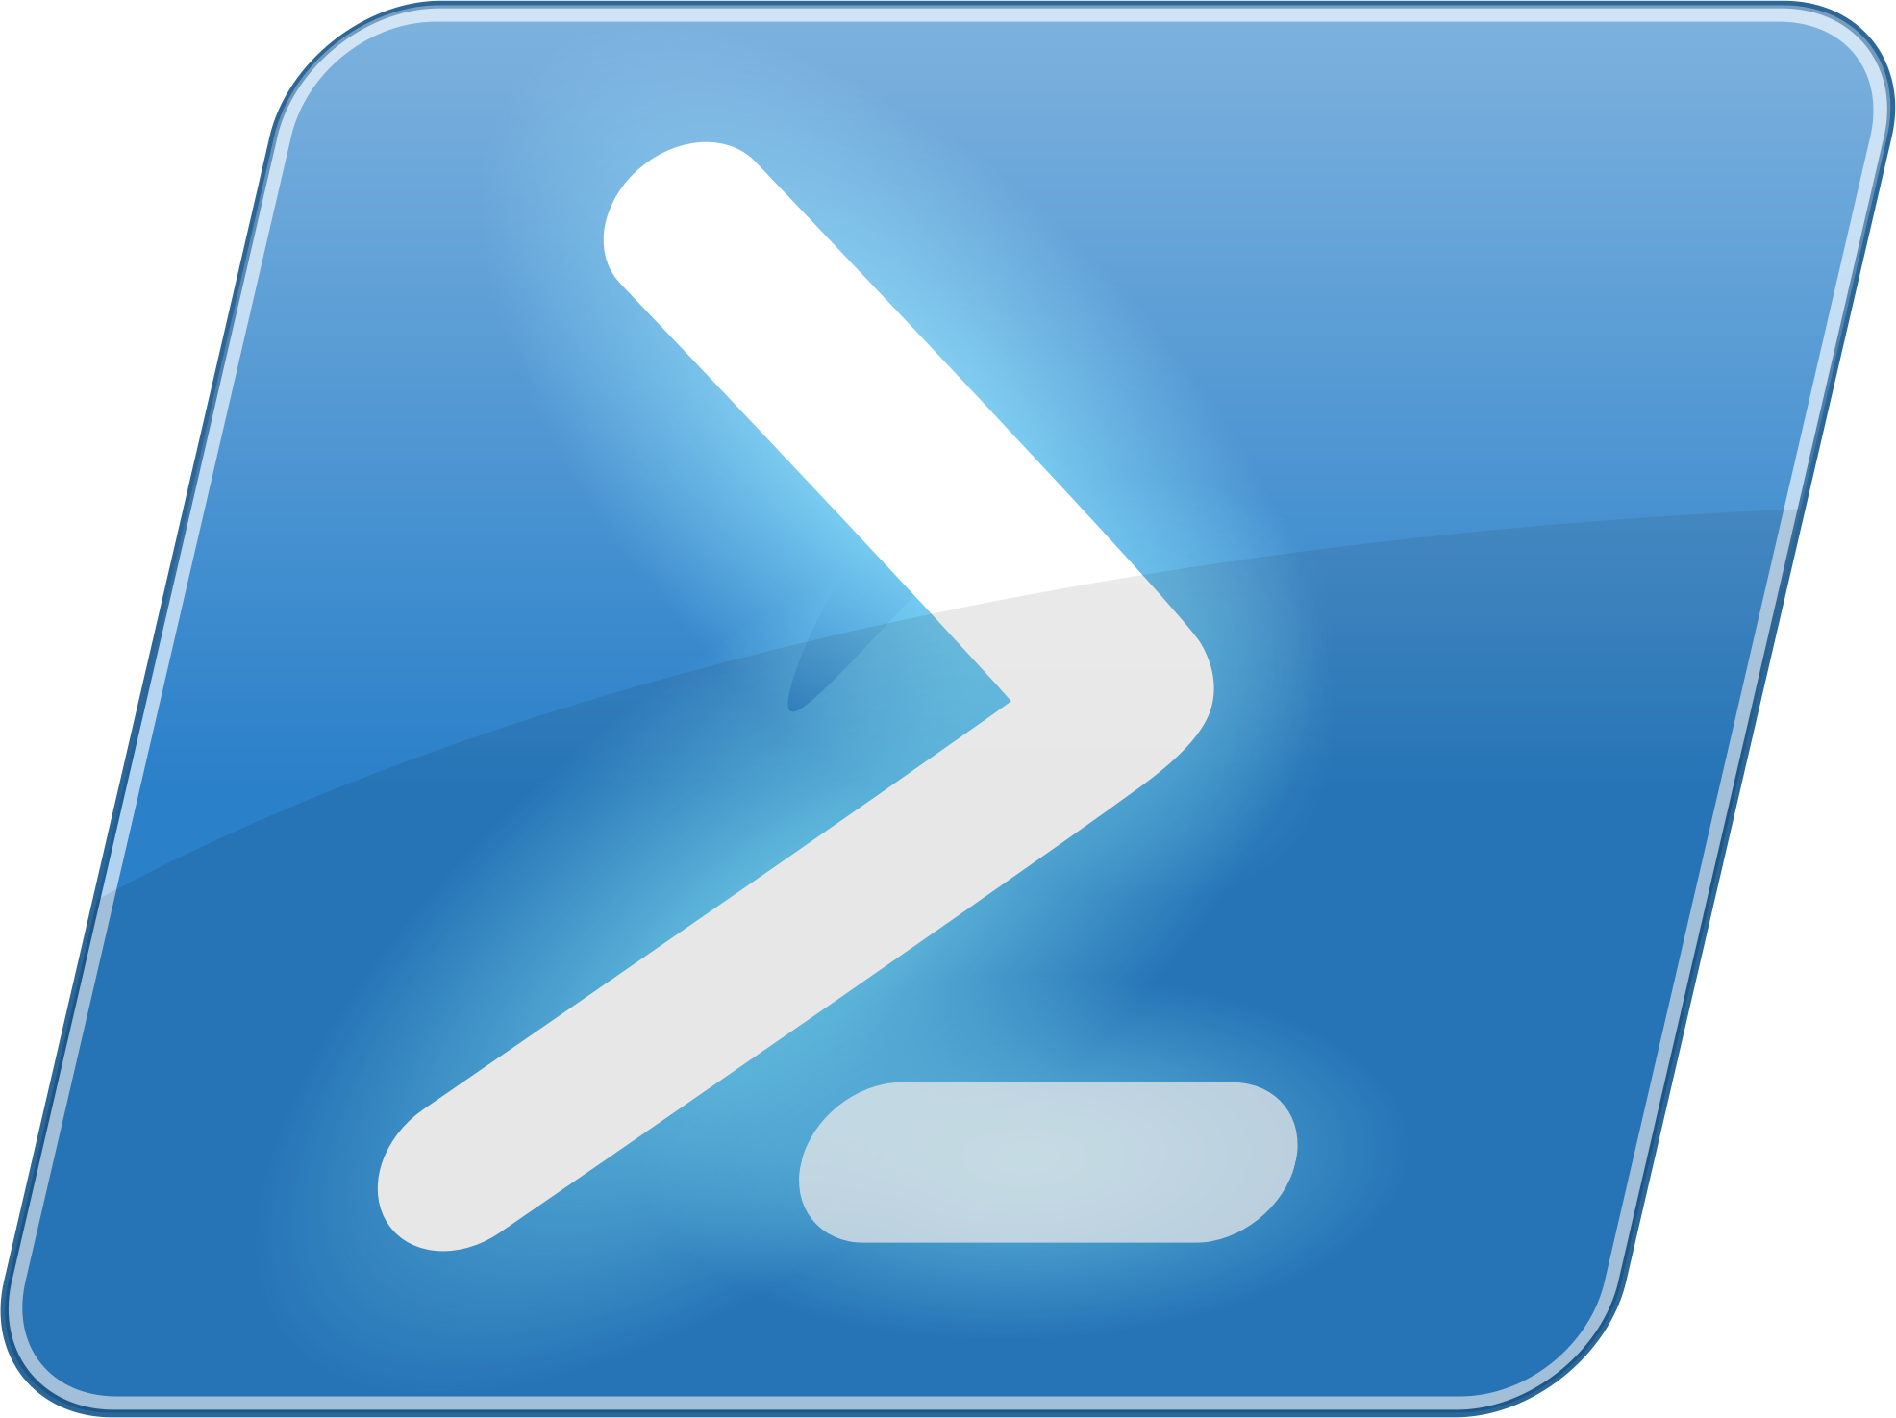
Programming Languages

Slide 28
go Programming Language (golang)
Easy to learn
Powerfull
Popular

Slide 29
python
Easy to learn
Powerfull
Popular

Slide 30

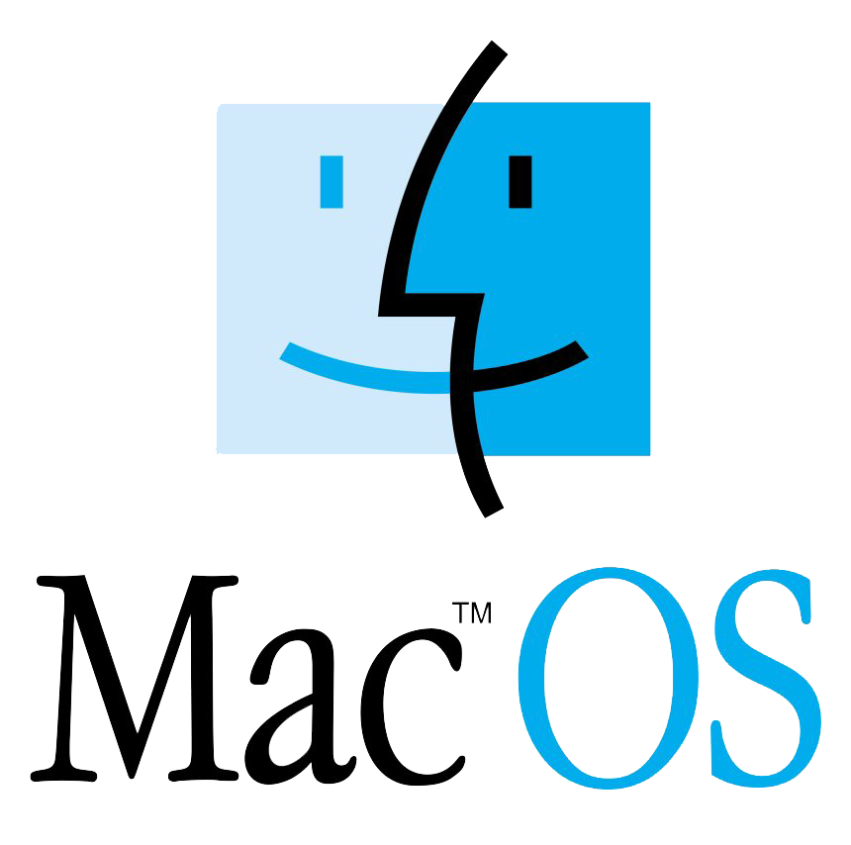
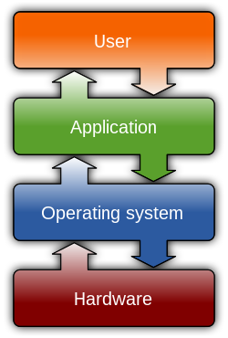

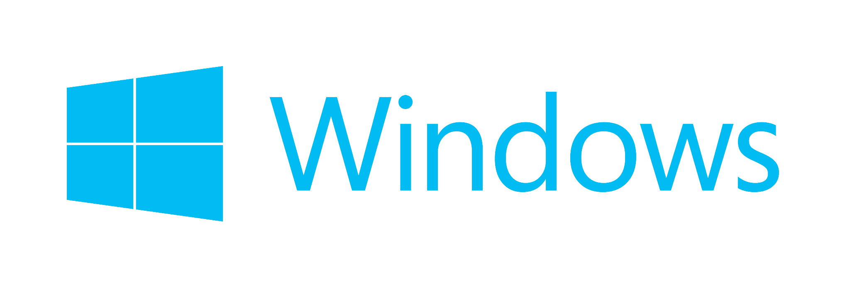
Operating Systems

Slide 31
Operating Systems
What an Operating System is
Anatomy of an OS
Types of Operating Systems
Popular Operating Systems
GNU/Linux
Flavors of Linux

Slide 32



Operating Systems
Some useful ci/cd tools

Slide 33
Networking Security and Protocols
HTTP
HTTPS
SSL
TLS
TELNET
SSH

Slide 34
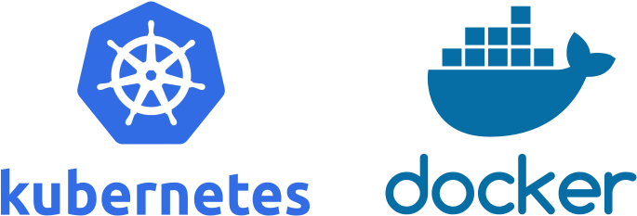
Infrastructure as Code

Slide 35
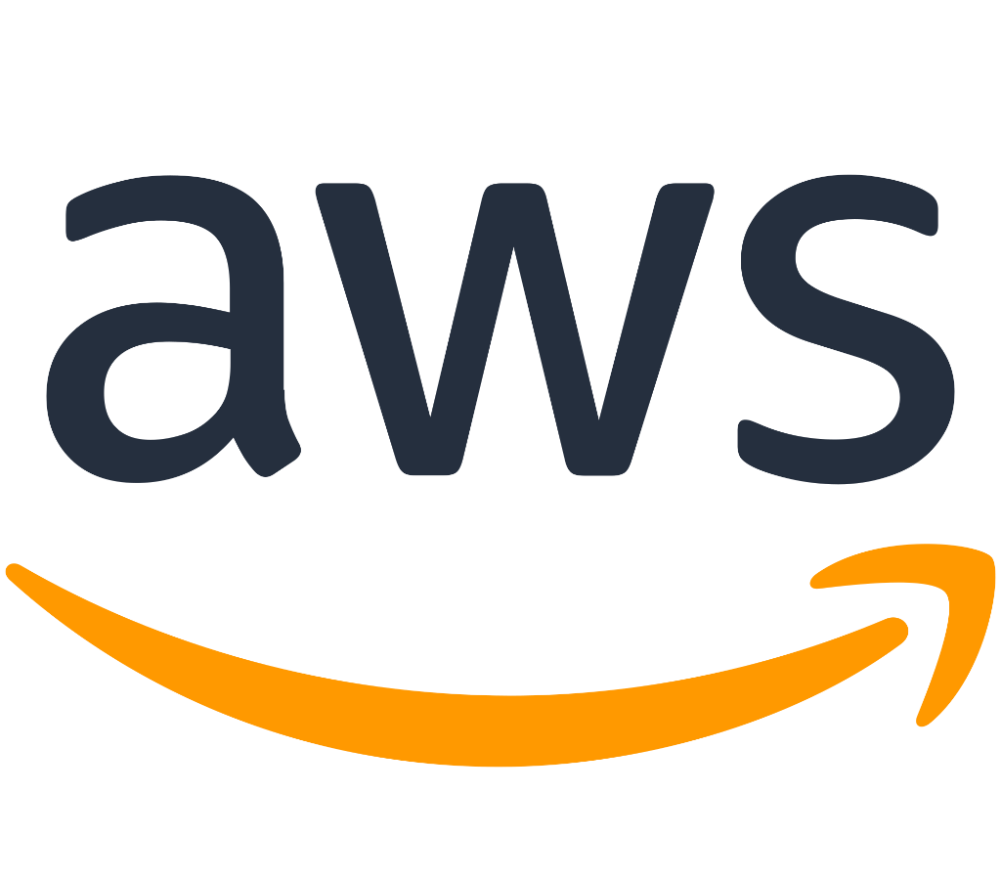

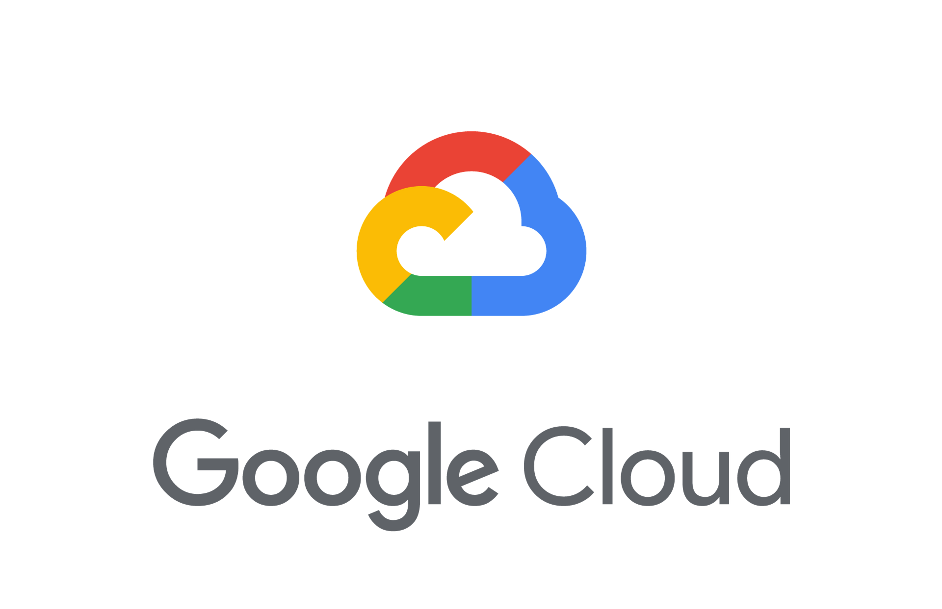
Public Cloud

Slide 36
Public Cloud
Easy to use
Fully Managed Services
Programmable

Slide 37
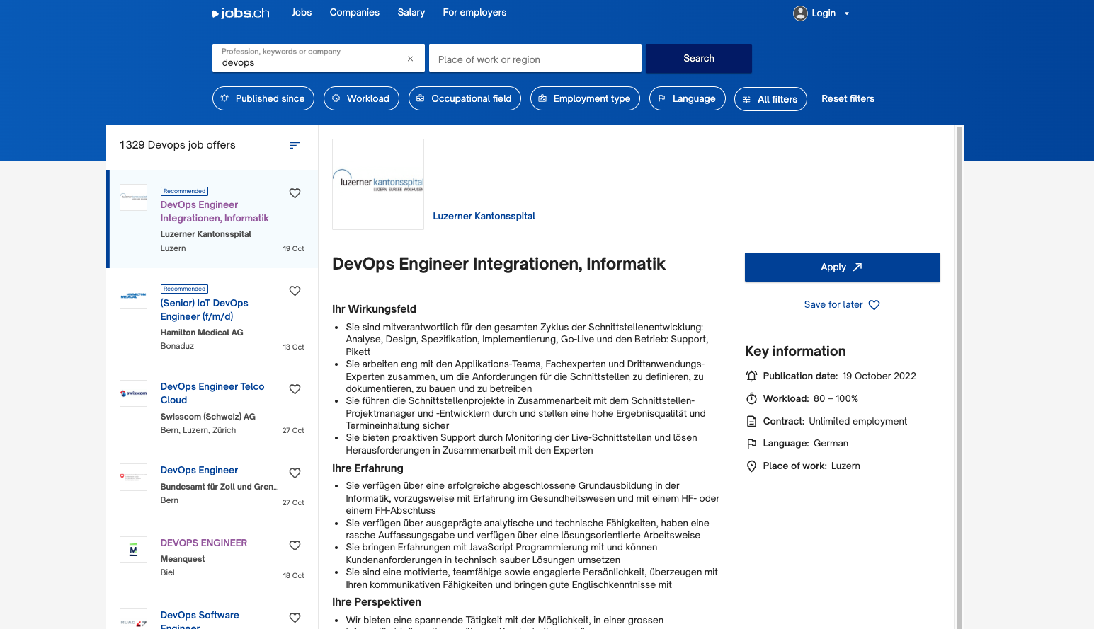
DevOps in Swiss Job Market

Slide 38
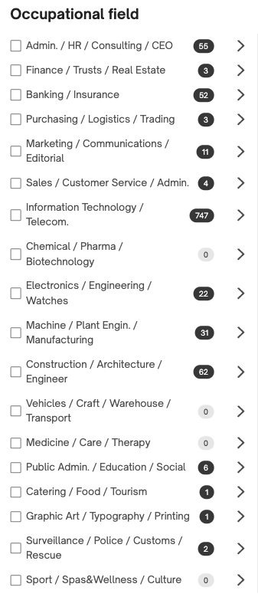
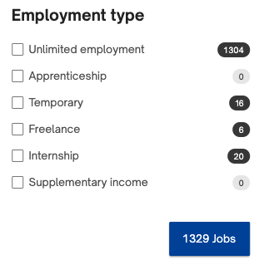
DevOps in Swiss Job Market

Slide 39

Is it really needed?

Slide 40

DevOps Advantages and Disadvantages

Slide 41


Advantages
DevOps is an excellent approach for quick development and deployment of applications

Slide 42


Advantages
It responds faster to the market changes to improve business growth

Slide 43


Advantages
DevOps escalate business profit by decreasing software delivery time and transportation costs.

Slide 44

Advantages
DevOps clears the descriptive process, which gives clarity on product development and delivery.

Slide 45

Advantages
It improves customer experience and satisfaction.

Slide 46

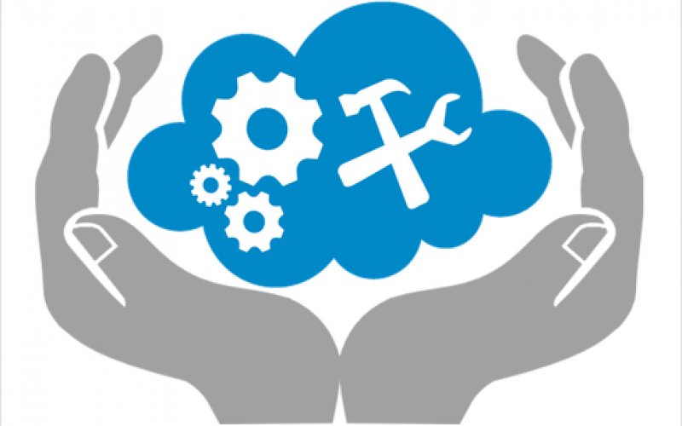
Advantages
DevOps simplifies collaboration and places all tools in the cloud for customers to access

Slide 47


Advantages
DevOps means collective responsibility, which leads to better team engagement and productivity

Slide 48


Disadvantages
DevOps professional or expert's developers are less available

Slide 49

Disadvantages
Developing with DevOps is so expensive.
Because
Good DevOps experts are in big demand and can be very expensive. The automation and other software tools they require, and other operational costs add up quickly to a very expensive initiative
Notes:
hghh

Slide 50

Disadvantages
Adopting new DevOps technology into the industries is hard to manage in short time

Slide 51


Disadvantages
Lack of DevOps knowledge can be a problem in the continuous integration of automation projects

Slide 52
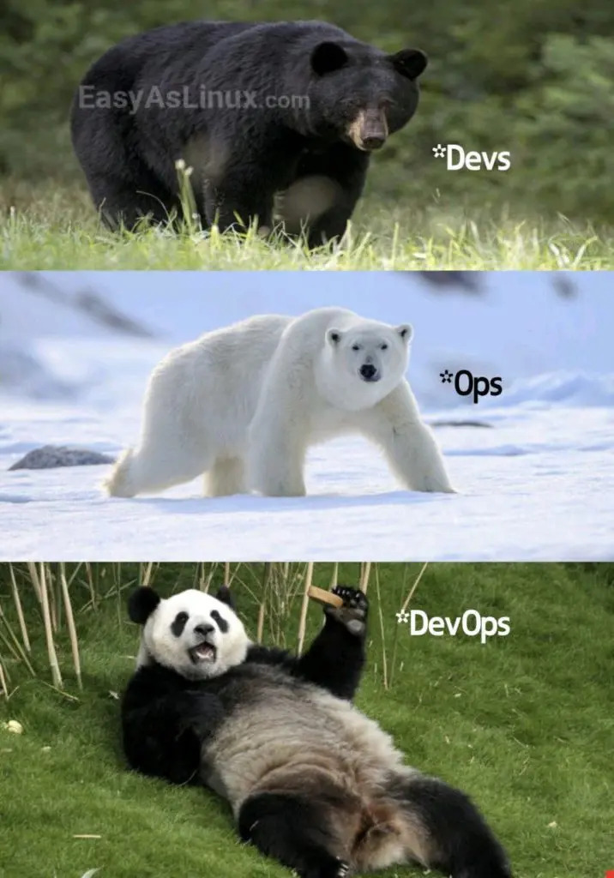
As a result…

Slide 53
Thank you for your attention
Any questions?

